Slide 1
Source separation with psycho-acoustic loss
Yifeng Yu, Alexander Lerch

Slide 2
Introduction – Source Separation
1. Current State of the Field:
MSE loss for time domain / frequency domain is mostly used in deep learning models for source separation.
2. The Need for a Novel Approach:
We need a loss that captures human auditory perception.
Evaluation metrics such as SDR are not perceptually relevant, so that progress in source separation optimizes towards the 'wrong' metrics

Slide 3
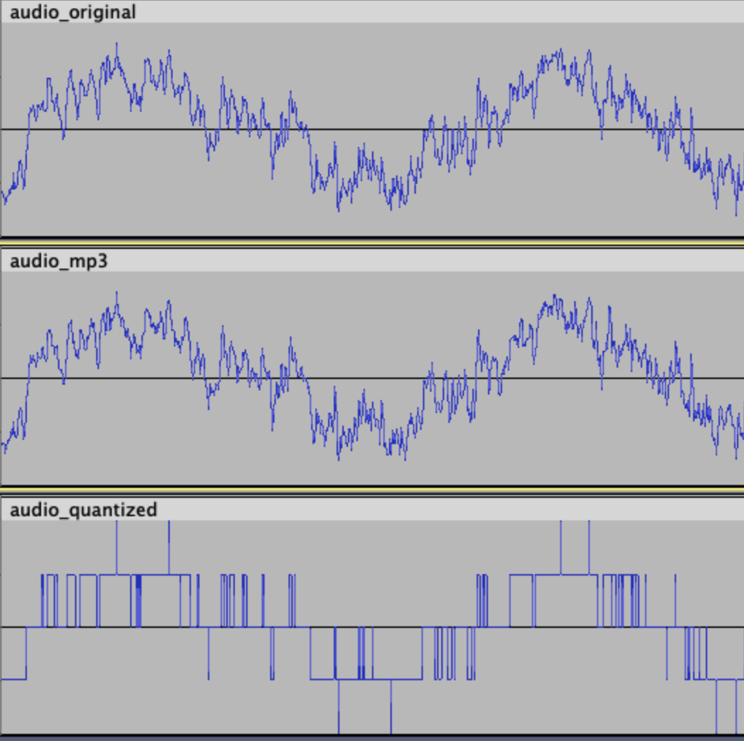
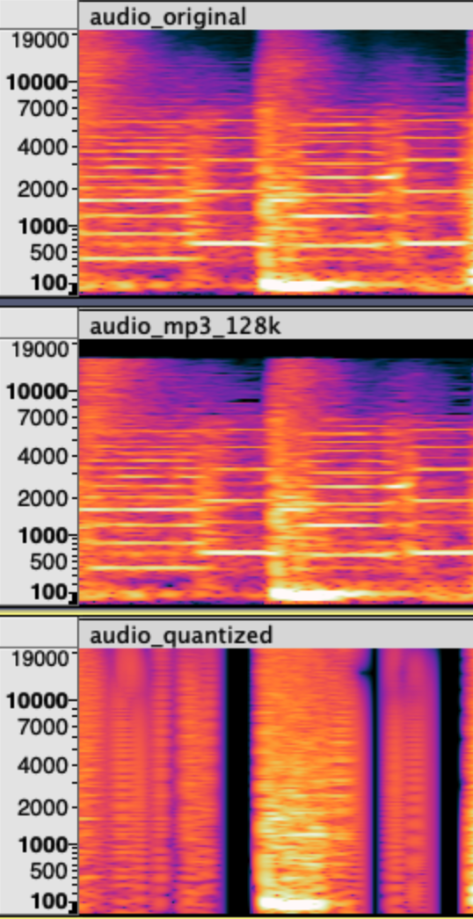

Example of perceptual differences
Original
mp3
Quantized
(bit = 4)

Slide 4
Example of different loss functions
Input audios | MSE (time domain) | MSE (Frequency domain) | Psycho-acoustic loss
Loss 1: Original, mp3 | 0.0003 | 2602.5522 | 232.1570
Loss 2: Original, Quantized | 0.0131 | 113671.4609 | 22683.1016
Loss 1 / Loss 2 | 0.0262 | 0.0229 | 0.0102
Main idea for designing the psycho-acoustic loss is to measure the perceptual similarity.
Inspired by Perceptual (MP3) encoding

Slide 5
Background: Perceptual Audio Encoding
Masking in Psycho-acoustics:
A key concept in psycho-acoustics is "masking". In the presence of one sound, another sound might be "masked" or not heard.
Applications in Perceptual Audio Encoding
Example: Used in MP3 compression.
Quantize sounds masked by dominant ones, retaining audio quality.
The masking threshold
The level where a sound is covered by a louder one and becomes inaudible.

Slide 6
Using Masking Threshold for Loss Design
Idea: If two audio clips have similar masking thresholds, they might be perceptually similar.
Our proposed loss: Calculate the difference (MSE) between the masking thresholds of two audio signals.
Objective: Minimize the difference for higher perceptual similarity.

Slide 7
Psycho-Acoustic Loss Calculation
Frequency Domain Transformation (FFT)
Transformation to a Perceptual Scale
Use Bark scale
Compute Masking Thresholds
Calculate the masking thresholds for each audio signal on the perceptual scale. We need to define a spreading function to calculate masking thresholds.
Apply LTQ (Listening Threshold in Quiet)
Calculate MSE of masking thresholds

Slide 8
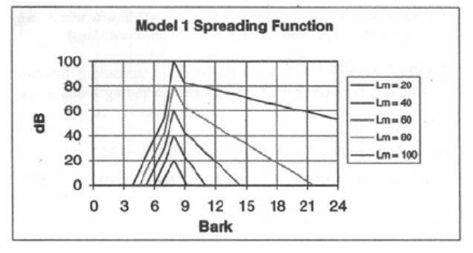
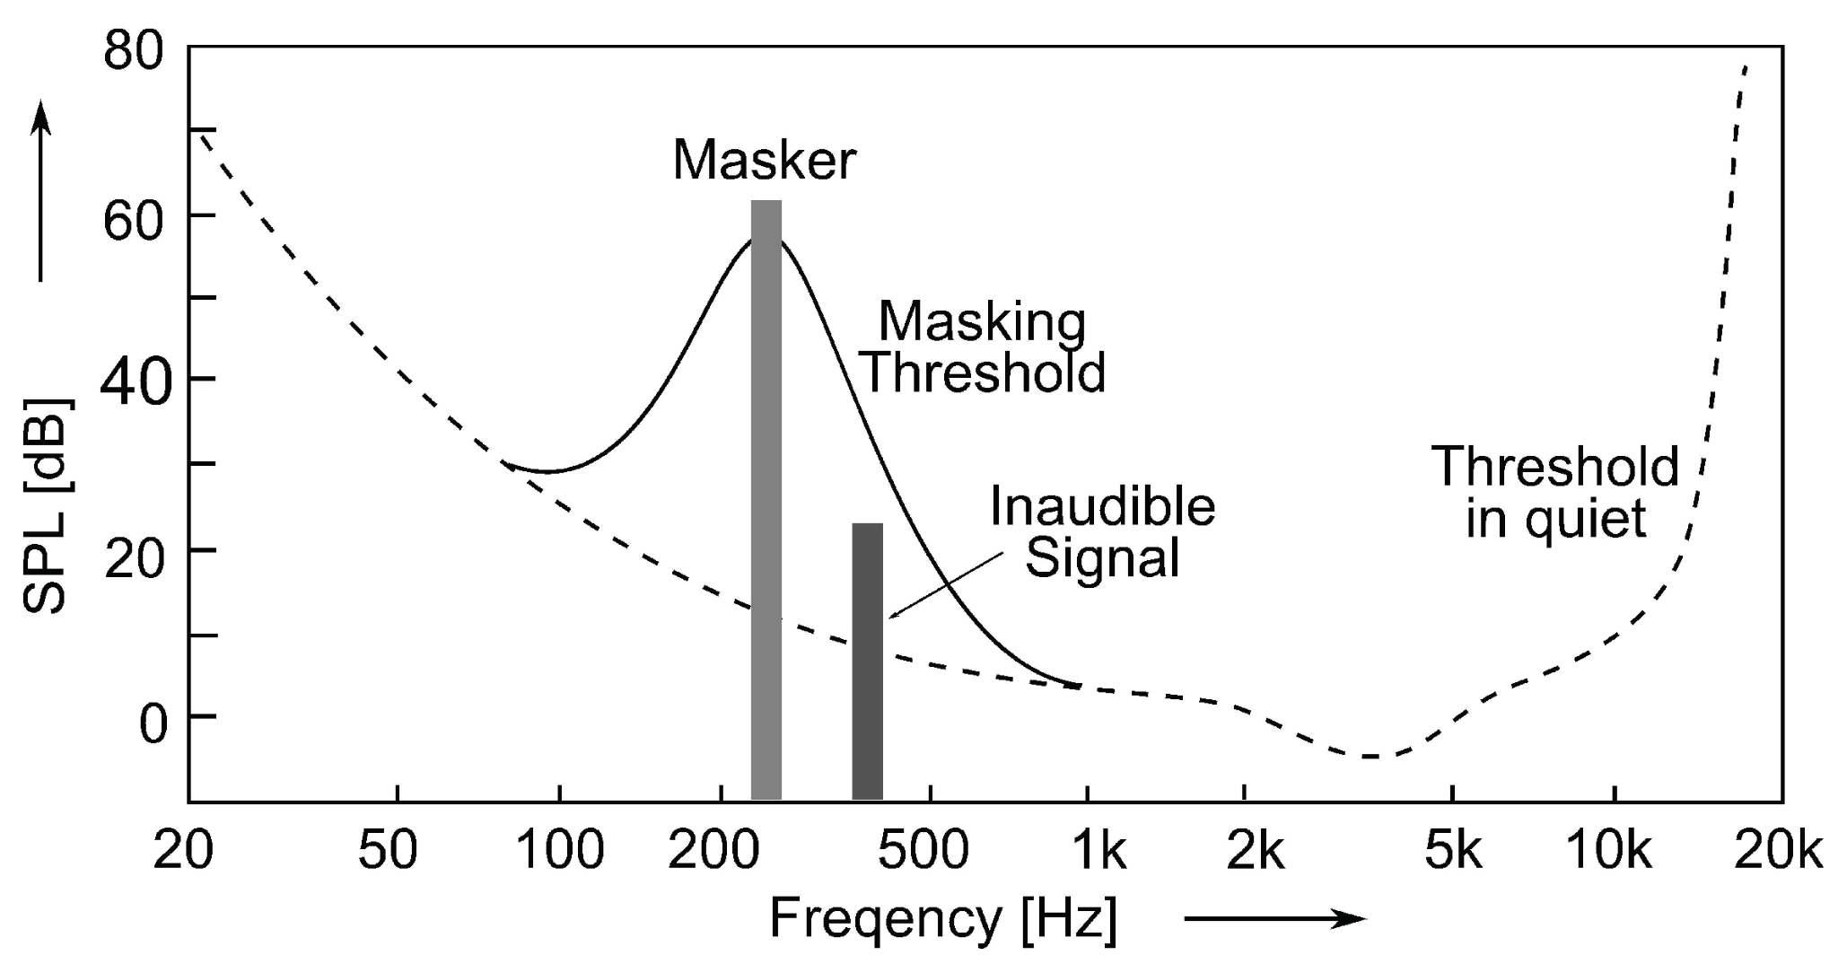
Masking Threshold Calculation
*
Spectrogram
Spreading function

Slide 9
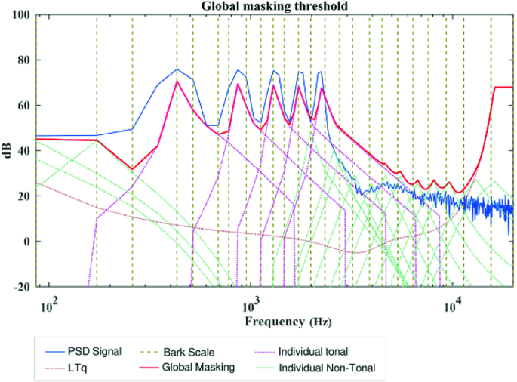
LTQ
LTQ represents the human ears’ sensitivity to sound at different frequencies in a quiet environment.

Slide 10
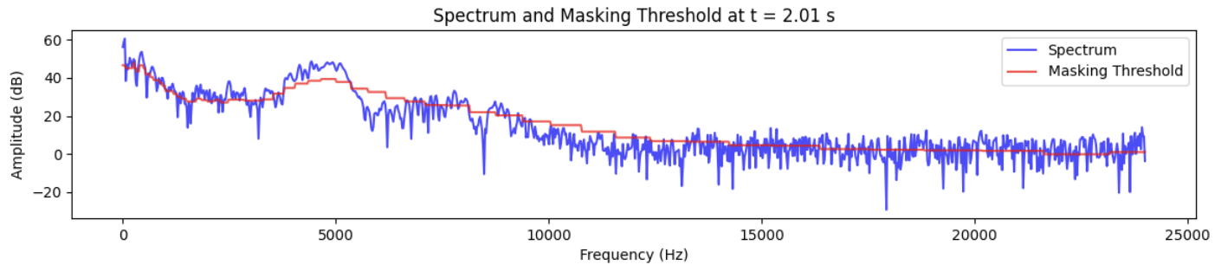
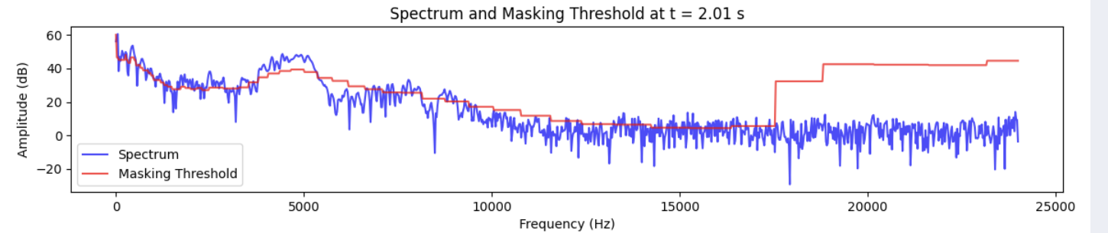
Psycho-Acoustic Masking Threshold Example
Without LTQ
With LTQ

Slide 11
Apply Psycho-acoustic loss in Source Separation
Baseline
Asteroid: The PyTorch-based audio source separation toolkit
Dataset
Musdb18: The musdb18 is a dataset of 150 full lengths music tracks (~10h duration) of different genres along with their isolated drums, bass, vocals and others stems.
Model
X-CrossNet-Open-Unmix (X-UMX): an improved version of Open-Unmix (UMX)
Multi-domain loss (MDL): Time domain & Freq domain

Slide 12
Apply Psycho-acoustic loss in Source Separation
Ongoing Experiments
Finetune the pretrained model using psycho-acoustic loss.
Incorporate the psycho-acoustic loss into the multi-domain loss and train the model from scratch
Adjust the weighting of psycho-acoustic loss over the training.
Future works
Add an ear prefilter
Change block size
Try different spreading functions and scales
Change Frequency resolution

